Slide 1
Mutual Fund Performance Evaluation with Active Peer Benchmarks
Written By David Hunter, Eugene Kandel, Shmuel Kandel, Russ Wermers
Presented By Zhao Zhang

Slide 2
1 Background
Use APB as an additional factor
Passive Strategies VS Active Management
Evolvement of evaluating methods: Sharpe Ratio → Jensen’s alpha using a single risk factor → Fama and French three-factor model → Carhart’s momentum added model
A problem: Similar strategies can lead to correlated residuals, reducing the power of models to separate skilled from unskilled fund managers
Another problem: Fund portfolio holdings data or knowledge about the commonalities may not be available (or are disclosed infrequently)
Need to figure out an approach to account for commonalities using only public information. (i.e. fund returns and the investment objective)

Slide 3
2 Motivating APB
Active Peer Benchmark
From the return on the group of funds to which a given fund belongs
Equally weighting (or value weighting) all funds in the group every period
How to justify?

Slide 4
3 Motivating APB
An unsophisticated investor who has decided asset allocation
A fallback strategy: periodically rebalanced, equal-weighted (value-weighted) portfolio
Invest more in funds generating risk-adjusted returns that significantly exceed those of APB
Within a peer group: similar securities, models, behavioral biases and geographical area
Peer-group return captures commonalities and improves estimation

Slide 5
4 Model Setup
Nine Style Fund Categories
Large-capitalization: total, value and growth
Mid-capitalization: total, value and growth
Small-capitalization: total, value and growth
APB-Augmented Four-Factor Model
Add APB to traditional four-factor model
EW-average, no-load funds
For hedge fund, one single factor

Slide 6
5 Model Setup
Define the gross excess return of fund i at time t:
$$r_{i,t}=R_{i,t}+m_{i,t}−r_{f,t}$$
where $R_{i,t}$ is return net of management fee, $m_{i,t}$ is periodic management fee, $r_{f,t}$ is risk-free rate
Also the gross excess return of the APB where fund i belongs:
$$r_{{APB}_{i},t}=\frac{1}{N_{{APB}_{i}}}\sum_{i=1}^{N_{{APB}_{i}}}{r_{i,t}}$$
(1)
(2)

Slide 7
6 Model Setup
Fund i errors have the following structure:
$r_{i,t}=α_{i}+β_{i}f_{t}+ε_{i,t}$ where $ε_{i,t}=ρ_{i}L_{t}+ω_{i,t}$
APB errors structure:
$r_{APB}=α_{APB}+β_{APB}f_{t}+ε_{APB,t}$ where $ε_{APB,t}=ρ_{APB}L_{t}+ω_{APB,t}$
$f_{t}$ -- priced risk factor ${ L}_{t}$ -- a zero mean random variable $ω_{i,t}$ -- an IID (across funds) error term
Substitute the expression for $L_{t}$, we get:
$$r_{i,t}=α_{i}+β_{i}f_{t}+\frac{ρ_{i}}{ρ_{APB}}ε_{APB,t}+[ω_{i,t}−\frac{ρ_{i}}{ρ_{APB}}ω_{APB,t}]$$
$$r_{i,t}=a_{i}+β_{i}f_{t}+\frac{ρ_{i}}{ρ_{APB}}({α_{APB}+ε}_{APB,t})+[ω_{i,t}−\frac{ρ_{i}}{ρ_{APB}}ω_{APB,t}]$$
(Take leverage into account)
(3)
(4)
(5)
--Augmented Model
(6)
--APB-Adjusted Alpha Model

Slide 8
7 Empirical Methodology
Data
Monthly NAV returns from 01/1980 to 12/2010
One shareclass for each fund, take 1/12 annual expense as monthly expense
Fund Categories
Principal-agent problems – “best fit” benchmark by CP
 | Value | Core | Growth
Large-Cap | Russell 1000 Value | Russell 1000 | Russell 1000 Growth
Mid-Cap | Russell Midcap Value | Russell Midcap | Russell Midcap Growth
Small-Cap | Russel 2000 Value | Russell 2000 | Russell 2000 Growth

Slide 9
8 Empirical Methodology
Baseline Model
$$r_{i,t}=α_{i}+β_{i,rmrf}r_{rmrf,t}+β_{i,smb}r_{smb,t}+β_{i,hml}r_{hml,t}+β_{i,umd}r_{umd,t}+e_{i,t}$$
Augmented Model
$$r_{i,t}=α_{i}+β_{i,rmrf}r_{rmrf,t}+β_{i,smb}r_{smb,t}+β_{i,hml}r_{hml,t}+β_{i,umd}r_{umd,t}+λ_{i}ε_{APB,t}+ε_{i,t}$$
APB-adjusted Alpha Model
$$r_{i,t}=a_{i}+β_{i,rmrf}r_{rmrf,t}+β_{i,smb}r_{smb,t}+β_{i,hml}r_{hml,t}+β_{i,umd}r_{umd,t}+λ_{i}{(α_{APB}+ε}_{APB,t})+ε_{i,t}$$
$r_{i,t}$ -- monthly NAV return + 1/12 * annual expense ratio – T-bills
$r_{rmrf,t}$, $r_{smb,t}$, $r_{hml,t}$, $r_{umd,t}$ -- market premium, size, book-to-market, momentum
(7)
(8)
(9)

Slide 10
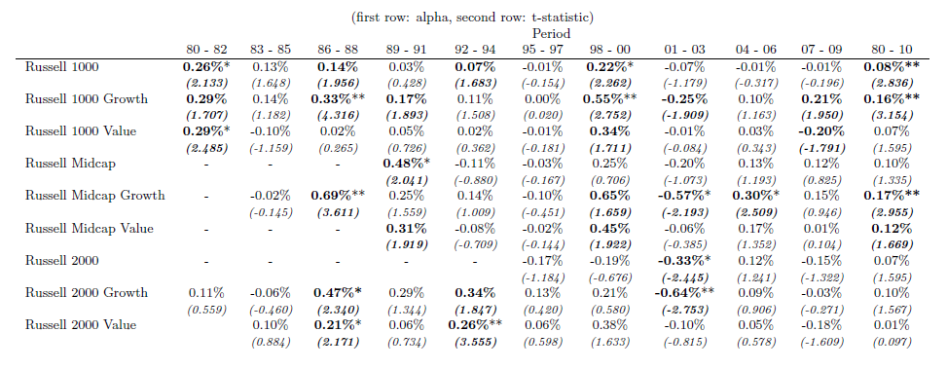
9 Results
APBs exhibit significant alphas
Can be quite sizably positive or negative
Tend to be of same sign across groups
Indicate a significant commonality in residuals among funds in each group; Correlation across groups?
Performance of APB

Slide 11
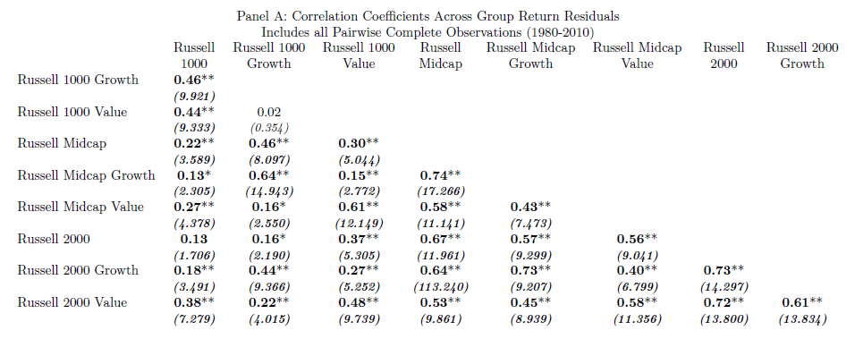
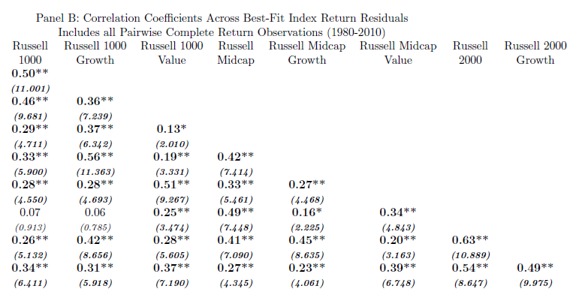
10 Results
Across-group correlation in idiosyncratic risk-taking
Especially dramatic for small-mid pairs
Index residual correlation is substantially different from fund.
Need to incorporate APB (even multiple factors)
Correlation Between APB Residuals

Slide 12
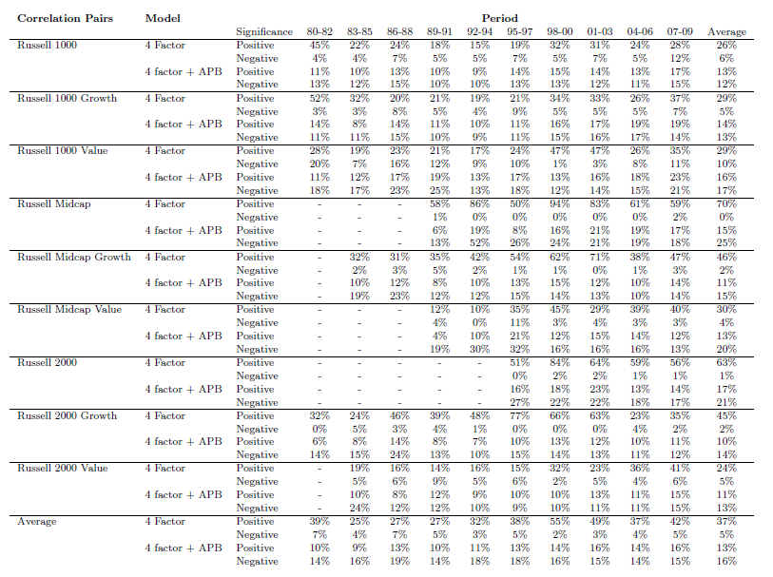
11 Results
Correlation Between Individual Fund Residuals
Significantly positive is much higher than negative
After adding APB, reasonably balanced positive and negative
APB successfully controls common idiosyncratic risk-taking

Slide 13
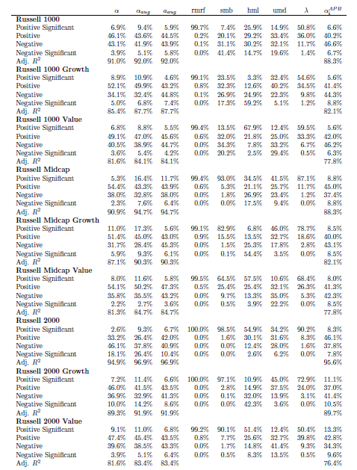
12 Results
Alpha Estimation Diagnostics
Divide into four groups based on value and t-statistic
Results of smb, hml…are consistent
Lamda is significantly positive over half of the funds
Alphas of four-factor and augmented model are equal, with different significances
Alphas of adjusted model should be close to zero
Pre-expense skilled funds do exist, and APB can precisely separate them; Some of them are due to common strategies.
Do these alphas persist? Due to common strategies or idiosyncratic strategies? Out of sample test.

Slide 14
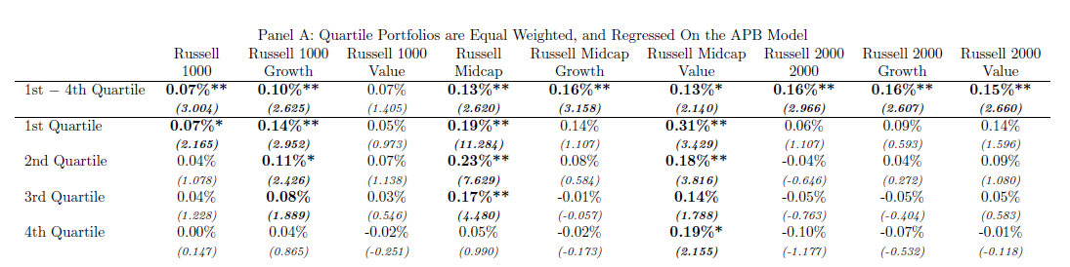
13 Results
Alphas monotonically decrease from quartile 1 to 4
Strong among mid, weak among small (trading cost)
After ruling out common strategies, still have significant persistence
Large and mid decrease, small increase
Skills among groups, both group-like and deviations from the group
Out-of-Sample Pre-Expense Alpha

Slide 15
14 Results
Qualitatively similar to the previous
Reduce persistence when controlling for the leveraged peer-group alpha
APB improves identification, partially due to capturing leveraged exposure to a common strategy
Out-of-Sample Pre-Expense Alpha

Slide 16
15 Results
Alphas drop from pre-expense value
Quite similar to gross-of-fee counterparts for both augmented and adjusted model
Under net-of-expense condition, APB is still good at locating persistently good/bad managers
Out-of-Sample Net Return Alpha

Slide 17
16 Results
Robustness test: Adding a Passive Index (PS)
Not as effective as using APB
Skilled manager are not merely loading on the mispricing of the market indexes.

Slide 18
17 Results
Robustness test: Adding a Liquidity Factor
Different augmenting factors capture different idiosyncratic factors
Do not eliminating alphas, indicating not achieving illusory alphas through loading on illiquid securities

Slide 19
18 Results
Robustness test: Value-Weighted APB
Qualitatively similar to EW-APB
Indicate a simplified and expedient way: aggregating the returns of the largest several funds within a group

Slide 20
19 Results
Robustness test: Multiple Active Peer Benchmarks
Augment the four-factor model with nine equally-weighted APB factors
(Lack tabulating results)
For the 1-st quartile, only two groups remain positive and significant
Loss in degree-of-freedom penalizes the model

Slide 21
20 Conclusion
Adding APB to the standard regression estimation:
Decreases the between-fund residual correlations, indicating that APB successfully captures common idiosyncratic risk-taking within a group
Performs just as well as multiple APBs, indicating that a group of funds tend not to use strategies that are common to other peer-groups
Significantly improves the identification of skilled fund managers

